Slide 1
4. Relationships: Regression
The Practice of Statistics in the Life Sciences
Third Edition
© 2014 W.H. Freeman and Company

Slide 2
Objectives (PSLS Chapter 4)
Regression
The least-squares regression line
Finding the least-squares regression line
The coefficient of determination, r ²
Outliers and influential observations
Making predictions
Association does not imply causation

Slide 3
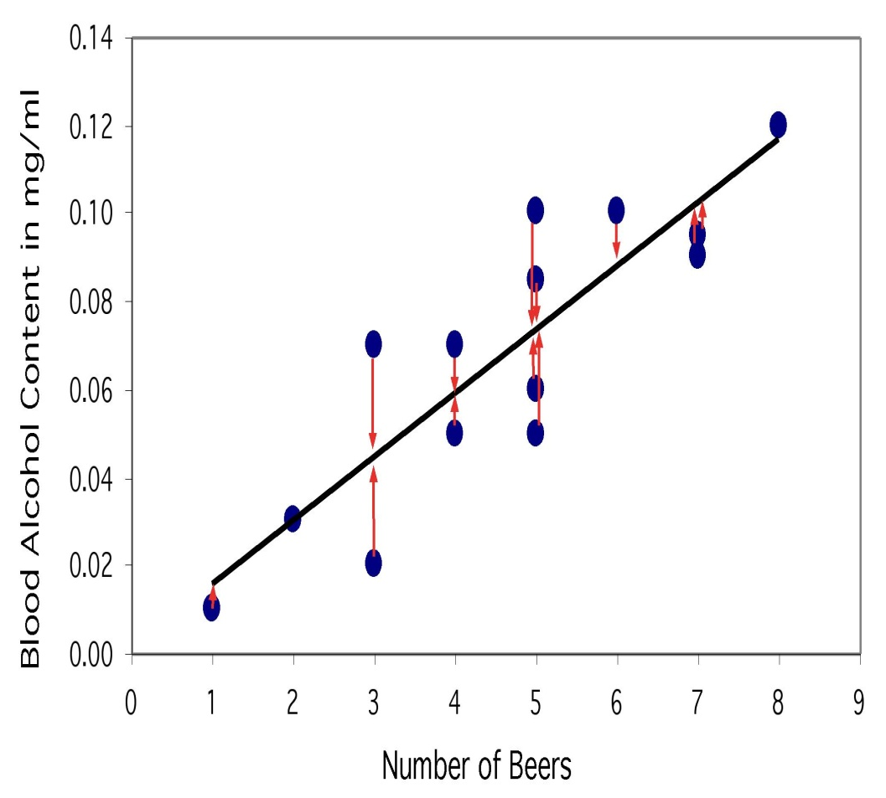
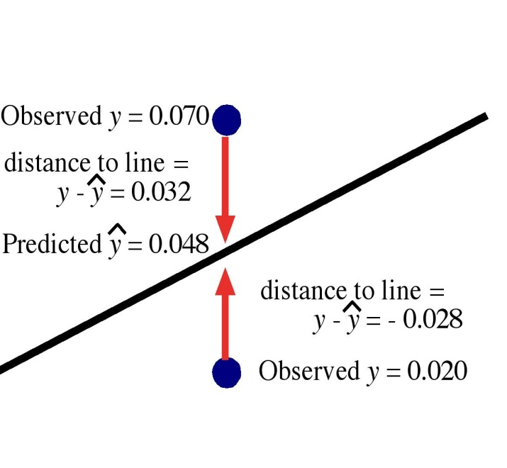
The least-squares regression line
The least-squares regression line is the unique line such that the sum of the vertical distances between the data points and the line is zero, and the sum of the squared vertical distances is the smallest possible.
Notes:
Because it is the “vertical distances” that are minimized, the distinction between x and y is crucial in regression.
If you switched the axes, you’d get a different regression line.
Always use the response variable for y, and the explanatory variable for x.

Slide 4
Notation
is the predicted y value on the regression line
slope < 0 slope = 0 slope > 0
Not all calculators/software use this convention. Other notations include:
Notes:
This textbook uses the notation b for slope and a for intercept. Students should know that different technology platforms may use variations of this notation.

Slide 5
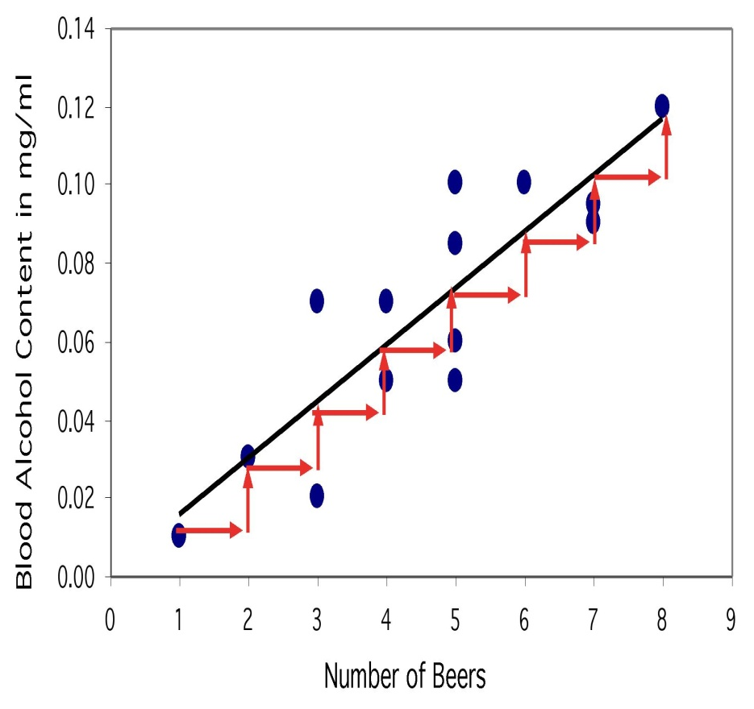
Interpretation
The slope of the regression line describes how much we expect y to change, on average, for every unit change in x.
The intercept is a necessary mathematical descriptor of the regression line. It does not describe a specific property of the data.

Slide 6
Finding the least-squares regression line
The slope of the regression line, b, equals:
r is the correlation coefficient between x and y
s_{y} is the standard deviation of the response variable y
s_{x} is the standard deviation of the explanatory variable x
The intercept, a, equals:
x̅ and y̅ are the respective means of the x and y variables
Notes:
This means that we don’t have to calculate a lot of squared distances to find the least-squares regression line for a data set. We can instead rely on these equations.
But typically, we use a 2-var stats calculator or a stats software.

Slide 7
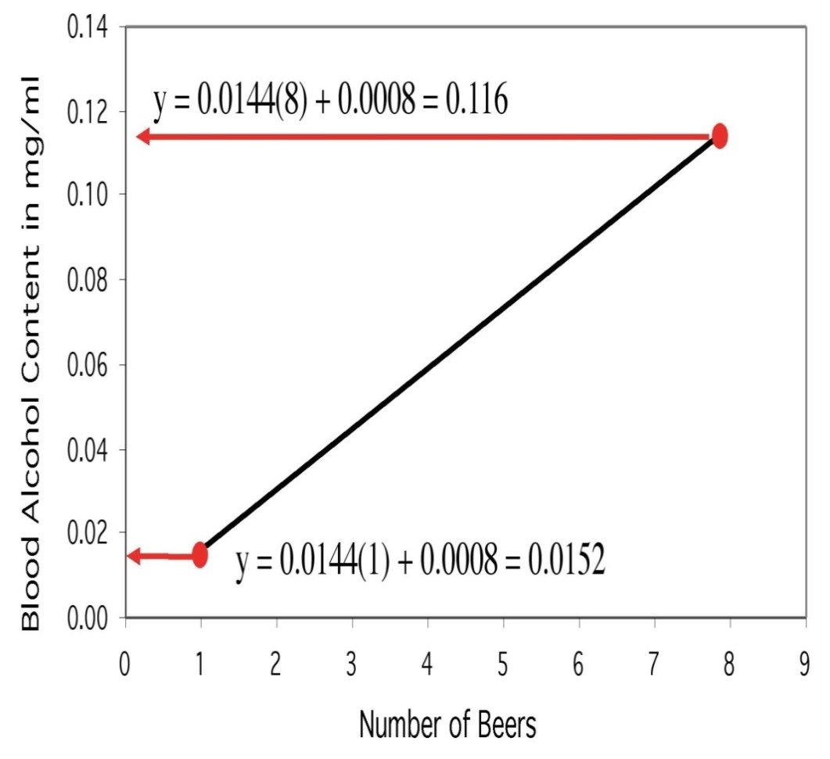
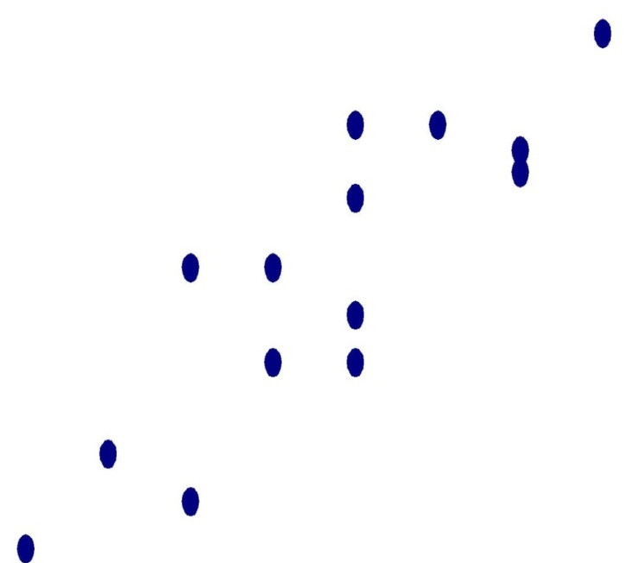
Plotting the least-square regression line
Use the regression equation to find the value of y for two distinct values of x, and draw the line that goes through those two points.
Hint: The regression line always passes through the mean of x and y.
The points used for drawing the regression line are derived from the equation.
They are NOT actual points from the data set (except by pure coincidence).

Slide 8
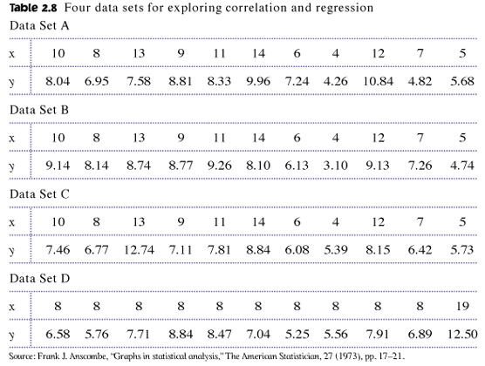
Least-squares regression is only for linear associations
Don’t compute the regression line until you have confirmed that there is a linear relationship between x and y.
ALWAYS PLOT THE RAW DATA
These data sets all give a linear regression equation of about ŷ = 3 + 0.5x.
But don’t report that until you have plotted the data.

Slide 9
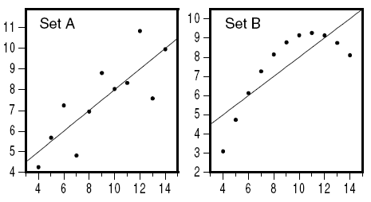
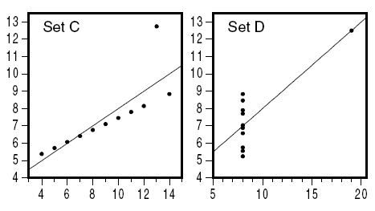
Moderate linear association; regression OK.
Obvious nonlinear relationship; regression inappropriate.
ŷ = 3 + 0.5x
ŷ = 3 + 0.5x
One extreme outlier, requiring further examination.
Only two values for x; a redesign is due here…
ŷ = 3 + 0.5x
ŷ = 3 + 0.5x
Notes:
Only data set A is clearly suitable for linear regression. Data set C is problematic because the outlier is very suspicious (likely a typo or an experimental error).

Slide 10




The coefficient of determination, r ²
r ², the coefficient of determination, is the square of the correlation coefficient.
r ² represents the fraction of the variance in y that can be explained by the regression model.
r = 0.87, so r ² = 0.76
This model explains 76% of individual variations in BAC
Notes:
Mathematically, it can be shown that r² is equal to the ratio SSRegression / SSTotal, or 1 minus SSError / SSTotal. Since SSTotal = SSRegression + SSError, r² is the fraction of the total sum of squares that is due to the regression model.
Note that the notation R² is also commonly used.

Slide 11
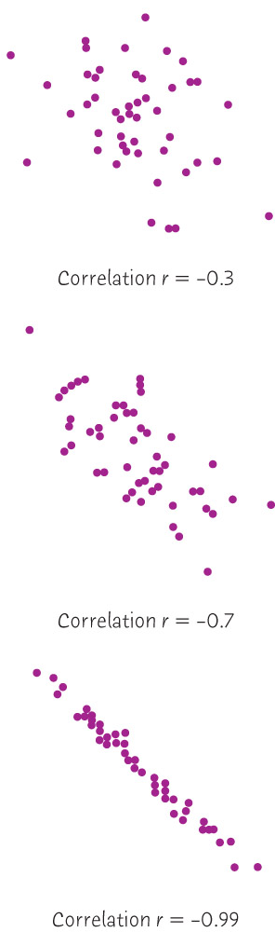
r = –0.3, r ² = 0.09, or 9%
The regression model explains not even 10% of the variations in y.
r = –0.7, r ² = 0.49, or 49%
The regression model explains nearly half of the variations in y.
r = –0.99, r ² = 0.9801, or ~98%
The regression model explains almost all of the variations in y.
Notes:
r quantifies the strength and direction of a linear relationship between two quantitative variables.
r is positive for positive linear relationships, and negative for negative linear relationships.
The closer r is to zero, the weaker the linear relationship is.
Beware that r has this particular meaning for linear relationships only.

Slide 12
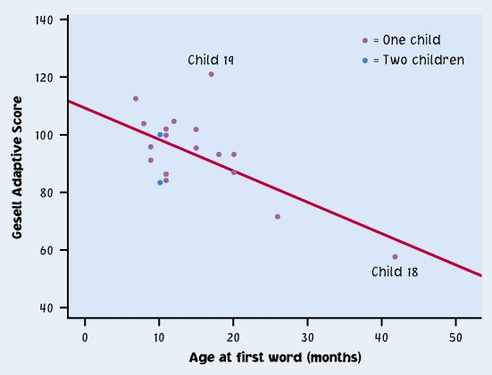
Outliers and influential points
Outlier: An observation that lies outside the overall pattern.
“Influential individual”: An observation that markedly changes the regression if removed. This is often an isolated point.
Child 19 = outlier (large residual)
Child 19 is an outlier of the relationship (it is unusually far from the regression line, vertically).
Child 18 is isolated from the rest of the points, and might be an influential point.
Child 18 = potential influential individual

Slide 13

Residuals
The vertical distances from each point to the least-squares regression line are called residuals. The sum of all the residuals is by definition 0.
Outliers have unusually large residuals (in absolute value).
Points above the line have a positive residual (under estimation).
Points below the line have a negative residual (over estimation).
^
Predicted y
Observed y

Slide 14
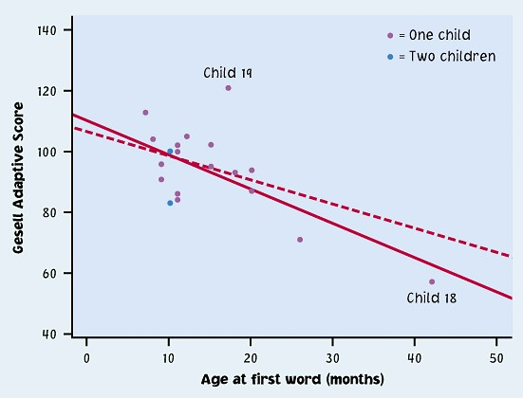
All data
Without child 18
Without child 19
Outlier
Influential
Child 18 changes the regression line substantially when it is removed. So, Child 18 is indeed an influential point.
Child 19 is an outlier of the relationship, but it is not influential (regression line changed very little by its removal).

Slide 15
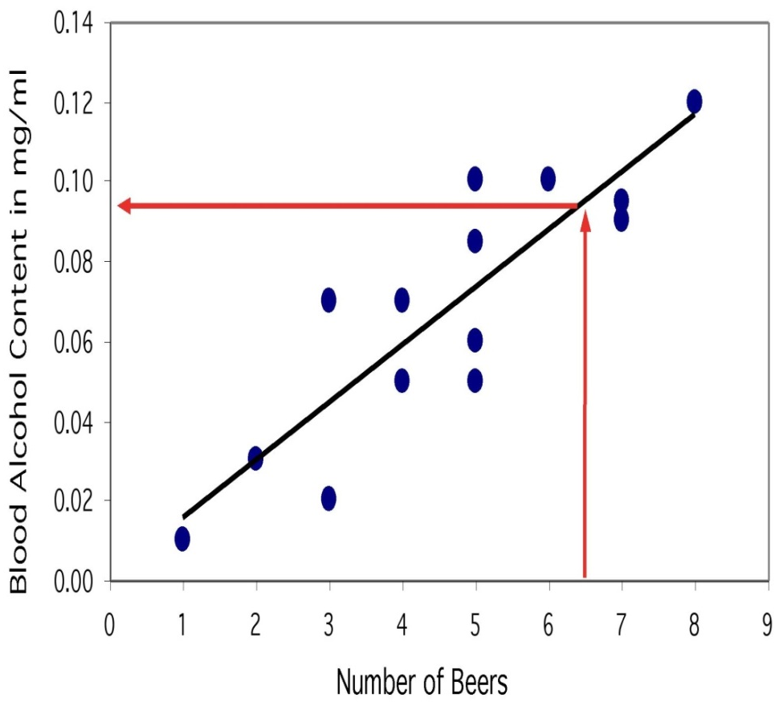
Making predictions
Use the equation of the least-squares regression to predict y for any value of x within the range studied.
Predication outside the range is extrapolation. Avoid extrapolation.
What would we expect for the BAC after drinking 6.5 beers?
Notes:
Nobody in the study drank 6.5 beers, but by finding the value of y from the regression line for x = 6.5, we would expect a BAC of 0.094 mg/ml.
With the data collected, we can use this equation for a number of beers drunk between 1 and 8 (prediction within range). Don’t use this regression model to predict the BAC after drinking 30 beers: That’s extrapolation. The person would most likely be passed out or dead!

Slide 16

Thousands powerboats | Manatee deaths
447 | 13
460 | 21
481 | 24
498 | 16
513 | 24
512 | 20
526 | 15
559 | 34
585 | 33
614 | 33
645 | 39
675 | 43
711 | 50
719 | 47
681 | 55
679 | 38
678 | 35
696 | 49
713 | 42
732 | 60
755 | 54
809 | 66
830 | 82
880 | 78
944 | 81
962 | 95
978 | 73
983 | 69
1010 | 79
1024 | 92
The least-squares regression line is:
If Florida were to limit the number of powerboat registrations to 500,000, what could we expect for the number of manatee deaths in a year?
➔ Roughly 21 manatee deaths.
Could we use this regression line to predict the number of manatee deaths for a year with 200,000 powerboat registrations?
Notes:
Number of powerboat registrations, and number of manatee deaths due to collisions with powerboats, in Florida each year, for the past three decades.
Beware that the data on powerboats are presented in thousands of registrations. So 500,000 powerboat registrations corresponds to the value 500 in our data set.
We should NOT use this regression model to predict the number of manatee deaths for 200,000 powerboat registrations because this would be prediction outside the range (extrapolation). In this case, extrapolation gives a nonsense prediction of negative 17.68 deaths!

Slide 17
Association does not imply causation
Association, however strong, does NOT imply causation.
The observed association could have an external cause.
A lurking variable is a variable that is not among the explanatory or response variables in a study, and yet may influence the relationship between the variables studied.
We say that two variables are confounded when their effects on a response variable cannot be distinguished from each other.
Notes:
Only careful experimentation can show causation. The important distinction between experiments and observational studies is made in Chapters 7 and 8.
The confounded variables may be either explanatory variables or lurking variables.

Slide 18


In each example, what is most likely the lurking variable? Notice that some cases are more obvious than others.
Strong positive association between the shoe size and reading skills in young children.
Strong positive association between the number firefighters at a fire site and the amount of damage a fire does.
Negative association between moderate amounts of wine-drinking and death rates from heart disease in developed nations.
Notes:
Top: Child age is most likely. As kids grow, their feet get bigger, and their reading skill improve with practice and schooling.
Middle: Extent of fire and site conditions are most likely.
Bottom: We can think of a long list of possible lurking variables (diet type, socialization, stress, general quality of life), but nothing as obvious as in the two previous examples.

Slide 19
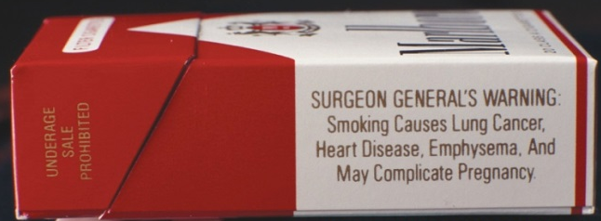
Establishing causation
Establishing causation from an observed association can be done if:
The association is strong.
The association is consistent.
Higher doses are associated with stronger responses.
The alleged cause precedes the effect.
The alleged cause is plausible.
Lung cancer is clearly associated with smoking.
What if a genetic mutation (lurking variable) caused people to both get lung cancer and become addicted to smoking?
It took years of research and accumulated indirect evidence to reach the conclusion that smoking causes lung cancer.

Slide 20
Least Square Example
Suppose we wanted to estimate a score for someone who had spent exactly 2.3 hours on an essay. I’m sure most of us have experience in drawing lines of best fit, where we line up a ruler, think “this seems about right”, and draw some lines from the X to the Y axis. In a room full of people, you’ll notice that no two lines of best fit turn out exactly the same. What we need to answer this question is the best fit line.
Through the magic of least sums regression, and with a few simple equations, we can calculate a predictive model that can let us estimate grades far more accurately than by sight alone. Regression analyses are an extremely powerful analytical tool used within economics and science. There are a number of popular statistical programs that can construct complicated regression models for a variety of needs. A simpler model such as this requires nothing more than some data, and maybe a calculator. It’s worth noting at this point that this method is intended for continuous data.

Slide 21
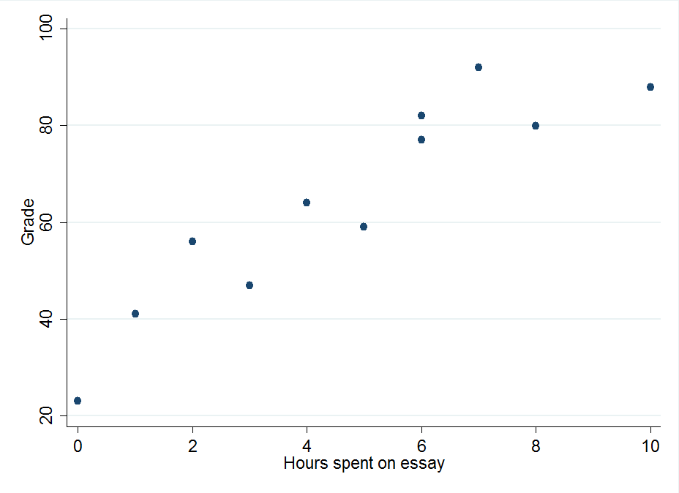
Least Square Example

Slide 22
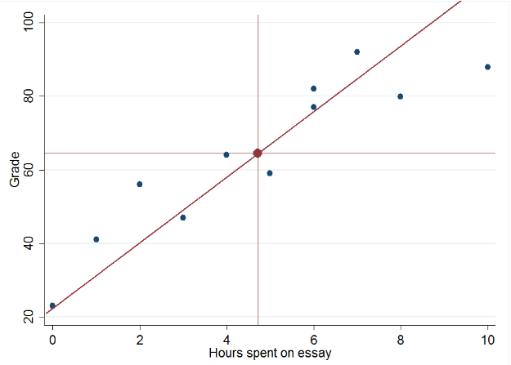
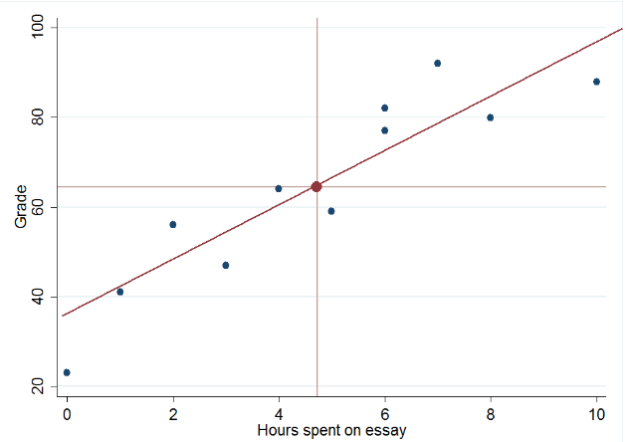
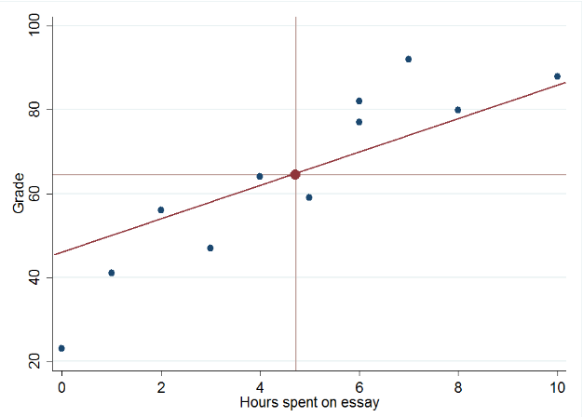
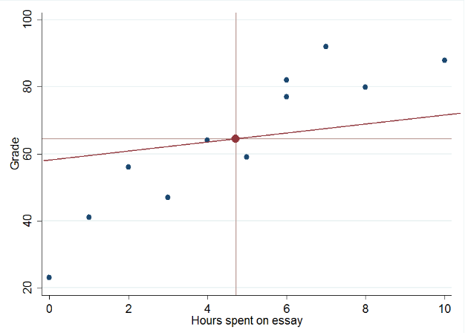
Least Square Example

Slide 23
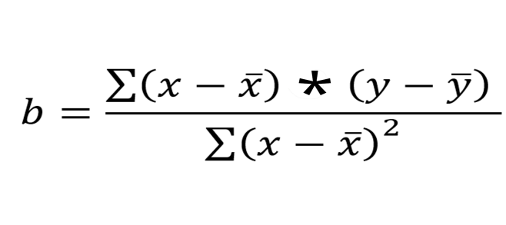
Least Square Example
Least Squares Regression Equations
The premise of a regression model is to examine the impact of one or more independent variables (in this case time spent writing an essay) on a dependent variable of interest (in this case essay grades). Linear regression analyses such as these are based on a simple equation:
Y = a + bX
Y – Essay Grade a – Intercept b – Coefficient X – Time spent on Essay
There’s a couple of key takeaways from the above equation. First of all, the intercept (a) is the essay grade we expect to get when the time spent on essays is zero. You can imagine you can jot down a few key bullet points while spending only a minute on an essay and still get a few points here and there. Every essay will have at least this score according to our model. On top of that, every hour we spent on our essays (X) leads to an increase of b in the grade the essay gets. We can work out b through the following, slightly scary equation:

Slide 24
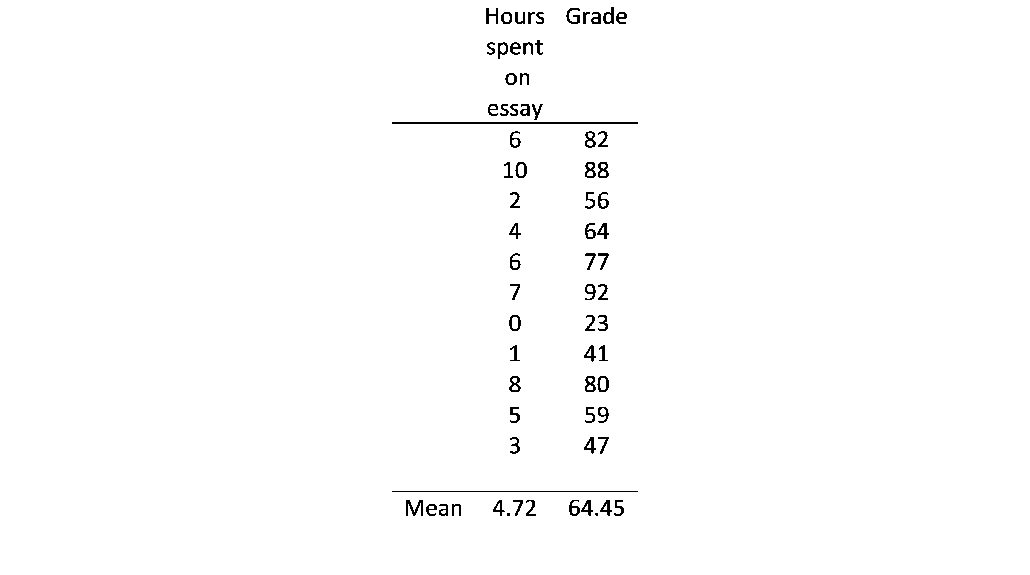
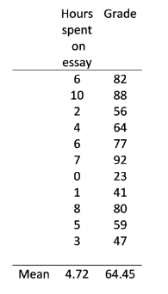
Least Square Example
But we’re getting ahead of ourselves. To calculate b, and make sense of that creepy equation, we’re going to need to know the values for our data:
But we’re getting ahead of ourselves. To calculate b, and make sense of that creepy equation, we’re going to need to know the values for our data:
When calculating least squares regressions by hand, the first step is to find the means of the dependent and independent variables. We do this because of an interesting quirk within linear regression lines - the line will always cross the point where the two means intersect. We can think of this as an anchor point, as we know that the regression line in our test score data will always cross (4.72, 64.45).
The second step is to calculate the difference between each value and the mean value for both the dependent and the independent variable. In this case this means we subtract 64.45 from each test score and 4.72 from each time data point. Additionally, we want to find the product of multiplying these two differences together.

Slide 25
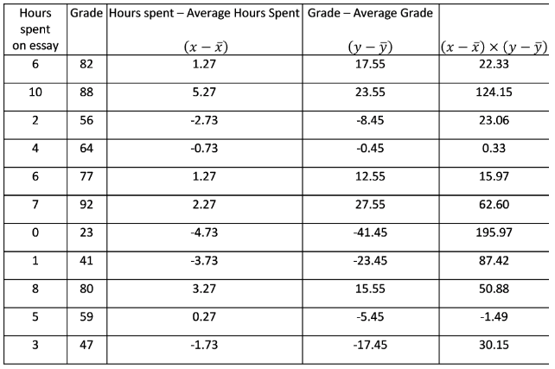
Least Square Example

Slide 26
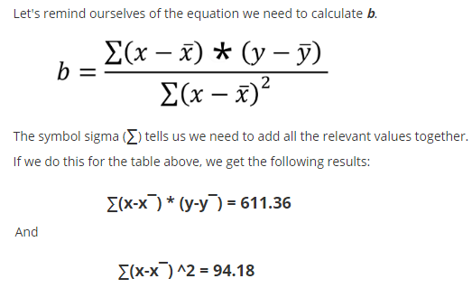
Least Square Example

Slide 27
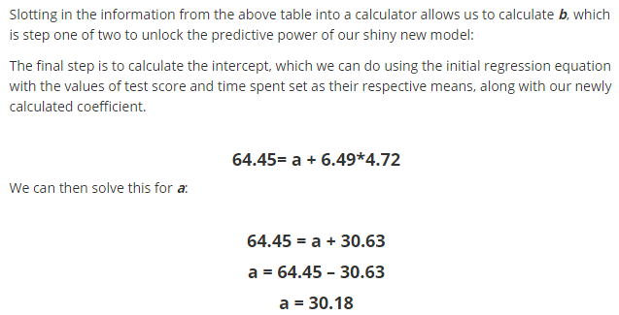
Least Square Example

Slide 28
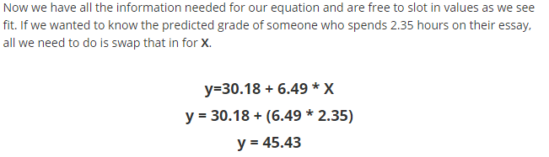
Least Square Example

Slide 29
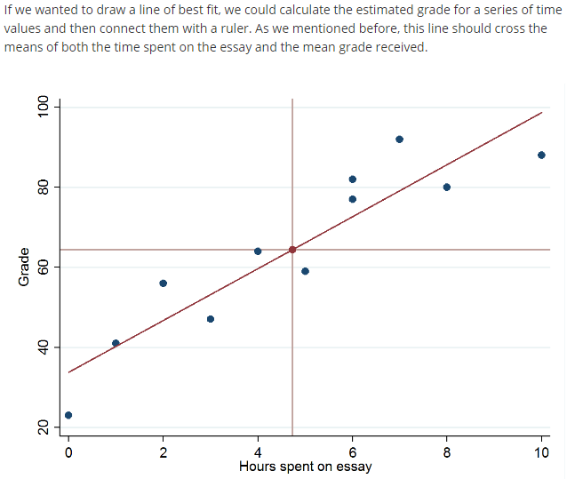
Least Square Example

